Slide 1
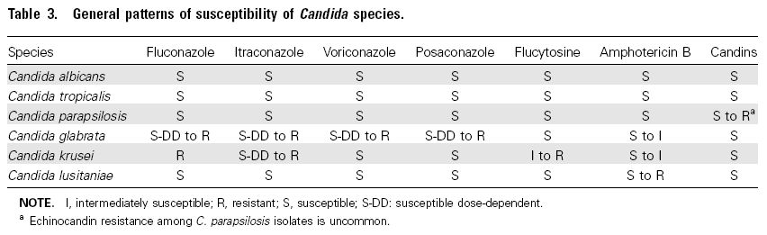
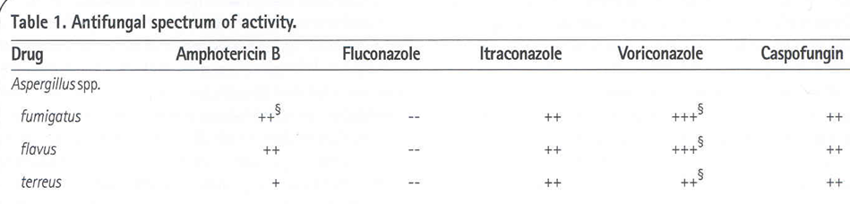

Slide 2
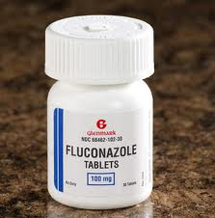
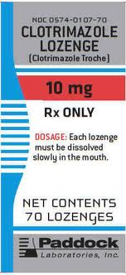
Empirical Non-Invasive Candidiasis
Ora pharyngeal
Candidiasis
Vulvovaginal
Candidiasis
Esophageal
Candidiasis
Can tolerate PO
Cannot tolerate PO
Mild/moderate:
Topical
Severe
Uncomplicated
Complicated
DM, immune
Fluconazole
150 mg 1x
Fluconazole
150 mg daily for 2 weeks
Clotrimazole Troche
5 times daily
+
Nystatin suspension
5 mL QID
Swish and shallow
Drug | Use Next Drug Down If:
Fluconazole 100 mg | Fluconazole Refractory Candida Krusei Candida Glabrata
Itraconazole | HF
Posaconazole | Cannot eat high fat meal
Drug | Use Next Drug Down If:
Fluconazole 200 mg | Fluconazole Refractory Candida Krusei Candida Glabrata
Itraconazole | HF
Posaconazole | Cannot eat high fat meal
Drug | Use Next Drug Down If:
#1 Fluconazole 400 mg | Used Fluconazole before (resistance) Candida Krusei Candida Glabrata
#2 AMB | Creatinine > 2.5 C. lusitaniae
#3 Echinocandin (caspo)
If Failed/Resistant
Drug | S/E
Voriconazole | Renal & hepatic

Slide 3
Invasive Candidiasis
Empirical
+ Urine Microscopy
Candidemia
Candiduria
Non-neutropenic
Neutropenic
ANC < 1000
or
Fever for 5 days despite antibiotics
Non-neutropenic
Neutropenic
ANC < 1000
or
Fever for 5 days despite antibiotics
Asymptomatic
Symptomatic
Neutropenic
Or
Neonate (low weight)
Pt undergo
Urologic Procedure
Cystitis
Pyelonephritis
Fungus Ball
surgery
Make it Definitive
Drug | Use Next Drug Down If
Echinocandin (caspofungin)
L-AMB 5 mg/kg q24h | Creatinine > 2.5 C. lusitaniae
Drug | Use Next Drug Down if
Fluconazole 200 mg q24h | Used Fluconazole before Candida Krusei Candida Glabrata
AMB 0.5 – 1.5 mg/kg q24h | Creatinine > 2.5 C. lusitaniae
Flucytosine
Drug | Use Next Drug Down If:
#1 Fluconazole 800 mg load 400 maintain | ANC < 1000 cells/cubic mm Used Fluconazole before (resistance) Candida Krusei Candida Glabrata
#2 Echinocandin (caspo) | Minor hepatotoxicity w/ cyclosporine
#3 L-AMB | Renal SCr > 1.5
Standard Dose
of fluconazole
Duration: 14 days after negative culture
Notes:
Amphotericin B Colloidal Dispersion (ABCD)
Amphotericin B Lipid Complex (ABLC)
Liposomal amphotericin B (LAmB)
Neutropenia
4,300 and 10,800 cells per microliter or cubic millimeter (cmm).
mild if the ANC ranges from 1000-1500/microL,
moderate with an ANC of 500-1000/microL, and
severe if the ANC is below 500/microL.

Slide 4
Treatment of specific Candida
Candida Albicans, Tropicalis, Parasilosis | Candida Lusitania | Candida Krusei | Candida Glabrata
Fluconazole | Fluconazole | Echino | Echinocandin
AMB | Not AMB | AMB
L-AMB | Not L-AMB
Echino

Slide 5
Aspergillosis
Empirical
Invasive Pulmonary
Drug | Use Next Drug Down If
Voriconazole 6 mg/kg q12h x2, then 4 mg/kg q12h | Isolated increase in bilirubin Visual (especially in children)
L-AMB
Caspofungin
Itraconazole
Voriconazole IV
Else
L-AMB
Echino
For 3 months to 1 year

Slide 6
Fungal Infection
Vulvovaginal Candidiasis
Invasive Candidiasis
Invasive Aspergillosis
Uncomplicated
Complicated
Recurring
Empirical Treatment
Definitive Treatment
SrCr > 1.4?
Child (vision)?
Susceptible to
Fluconazole
Resistant to
Fluconazole:
C. Glabrata
C. Krusei
Fluconazole 150 mg PO
X1 day
Fluconazole 150 mg PO
Every other day for
10 – 14 days
Fluconazole 150 mg PO
Every other day for
14 days
+
Followed by maintenance
Fluconazole 150 mg PO
Weekly for
6 months
Echinocandin
Or
Fluconazole
Loading Dose 800 mg PO
400 mg PO daily for 2 weeks
Fluconazole
Is preferred
Echinocandin
No
Voriconazole
Yes
Echinocandin
(Use Caspofungin)
Else
Voriconazole
or
Amphotericin
Else
Voriconazole
Or
Amphotericin
Else if resistant to Fluconazole
Use Echinocandin (Caspofungin)

